Slide 1



STUDENT DETAILS:
NAME : MOLLI MOHAN KISHORE
ROLL NUMBER : 22Q75A0351
EMAIL : mohankishoremolli9640@gmail.com
BRANCH : MECHANICAL
COLLEGE : AVANTHI INSTITUTE OF ENGINEERING AND TECHNOLOGY

Slide 2

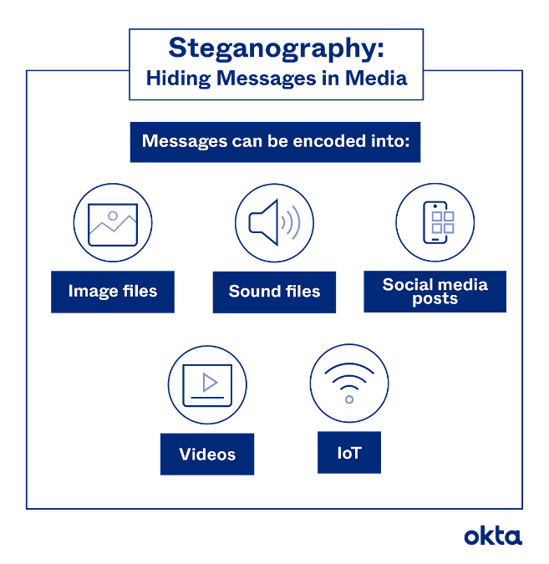
Hiding a Text Inside an Image Using Steganography
1
Secure Communication
Steganography is a technique that allows secret messages to be hidden within seemingly innocent files like images or audio.
2
Data Hiding
This method is often used to safeguard sensitive information by concealing it within an image, making it less obvious to potential attackers.
3
Data Security
Steganography plays a role in maintaining data security by making it challenging for unauthorized individuals to detect or intercept sensitive information.

Slide 3
Agenda
Project Overview
1
This section will cover the project's main goals and objectives, providing a comprehensive understanding of my work.
2
End Users and Their Needs
An exploration of the target audience for this project, focusing on their specific requirements and expectations.
Solution and Value Proposition
3
A detailed breakdown of my proposed solution and its benefits for the intended users.
4
Customization & Implementation
Delving into how the solution was tailored to meet the specific needs of the project and the steps involved in its implementation.
Conclusion
5
A summary of the key takeaways from the project, highlighting its significance and the skills developed during the internship.

Slide 4


Project Overview
Project Title
my project focused on developing a steganography tool. This tool allows users to embed secret messages within images in a way that is not readily apparent to the naked eye.
Project Goal
The primary objective was to create a user-friendly application that enables secure communication by hiding messages within images. The project aimed to provide a practical solution for safeguarding sensitive information.
Project Scope
my project encompassed the design, development, and testing of the steganography tool. This involved selecting suitable algorithms for message embedding, implementing these algorithms, and ensuring the tool's effectiveness in hiding and retrieving messages.

Slide 5
Who are the End Users
Individuals
Organizations
Researchers
Individuals seeking to communicate privately or securely, for example, family members sharing sensitive information or activists protecting their communications.
Businesses or organizations aiming to protect confidential data, such as financial institutions safeguarding customer information or government agencies handling classified documents.
Researchers working on data security and privacy, who may use steganography tools to explore new techniques for data hiding and protection.

Slide 6





Your Solution and its Value Proposition
User-Friendly Interface
my steganography tool boasts a user-friendly interface that makes it easy for users with varying technical expertise to utilize the application.
Strong Encryption
The tool utilizes strong encryption algorithms to ensure that hidden messages are protected from unauthorized access, further enhancing data security.
Cross-Platform Compatibility
AFTER ENCRYPTION
The steganography tool is designed to be compatible across multiple operating systems, ensuring its accessibility to a broader range of users.

Slide 7


How did you customize
Algorithm
my implemented the Least Significant Bit (LSB) steganography algorithm for hiding data within images. This technique involves altering the least significant bits of an image's pixels to store the hidden message.
Image Format
The tool supports various image formats, including JPEG, PNG, and GIF, providing users with flexibility in choosing their preferred image format for message embedding.
Security Measures
my incorporated robust security measures into the tool, such as password protection for hidden messages, preventing unauthorized access and ensuring data privacy.

Slide 8
MODELLING
Step 1: importing some libraries like cv2 and os for accessing relevant concept into code.
Step 2: After converting the text into their ascii values then that ascii values are stored in variable.
Step 3: Read the image from it’s path and hiding the image using XOR operation , RGB mechanism
Step 4: A secret is created to avoid unauthorized users.
Step 5: To unhide the image user wants to enter the secret key.
Step 6: Finally, user can able to see the secret message.

Slide 9





Conclusion
Skill Development
My gained valuable skills in programming, data security, and user interface design during this internship. She also deepened her understanding of steganography techniques and their practical applications.
Project Impact
my steganography tool has the potential to contribute to secure communication in various settings, empowering individuals and organizations to protect sensitive information.
Future Exploration
The project serves as a foundation for further exploration of advanced steganography techniques, exploring ways to enhance the tool's security and efficiency.

Slide 10

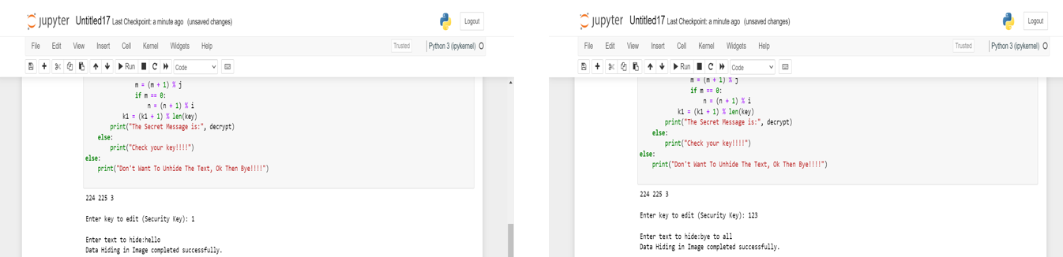

RESULT

Slide 11

LINKS:
https://github.com/MOHANKISHOREMOLLI/CYBER-SECURITY-STEGANOGRAPHY
https://github.com/MOHANKISHOREMOLLI/CYBER-SECURITY-STEGANOGRAPHY/tree/main/PPT%20OF%20STEGANOGRAPHY/CODE%20FOR%20STEGANOGRAPHY

